Slide 1
Casanova: a Language for Computer Games
Giuseppe Maggiore Alvise Spanò Renzo Orsini Michele Bugliesi Mohamed Abbadi

Slide 2
Agenda
Intro
Anatomy of a game
Anatomy of a Casanova game
Syntax, semantics, types
Optimizations
Rendering
Networking

Slide 3
Motivation
A need for disciplined research efforts:
Simulations/VR
Indie games
Serious games
Fast prototyping
Educational game-development

Slide 4
What is Casanova?
Casanova is:
A language…
A model…
A design pattern…
…to build games

Slide 5
Advantages of Casanova
Focused
No technical details
Comprehensive solution for entire game architectures
Game logic
Scripting
Input
Rendering
Networking
…

Slide 6
Anatomy of a traditional game
type Game<'s> =
{ World : 's
Update : 's -> Dt -> Input -> 's
Draw : 's -> ScreenFrame }
let run_game (g:'s Game) =
let rec loop (g:'s Game) (t:Time) =
let t'= GetTime()
let dt = t' - t
let s' = g.Update s' dt (read_input())
do g.Draw s'
do loop {g with World = s'} t'
in loop g (GetTime())

Slide 7
Shortcomings?
Says really nothing…

Slide 8
Casanova model for games
Essentially, just the GameState ('s)

Slide 9
Syntax
GameState, Entities, Initial state, main, input scripts

Slide 10
Syntax
Program ::= (Type-decl)* (Let-binding)* Expr
Type-decl ::= type Id [('a, ..)] = Type-body
Type-body ::= Type
| { Id [: Type] = Expr; .. }
| Uid [of Type] | ..
Type ::= 'a | Id [(Type, ..)]
| Type * .. * Type | Type + Type
| ref Type | var Type | rule Type
| script Type | table Type
Let-binding ::= let Pattern = Expr
| let rec Pattern = Expr and ..
Pattern ::= _ | Id | Uid [Pattern] | (Pattern, ..)
| Pattern as Id | (Pattern | Pattern)
| Pattern : Type
Expr ::= Lit | Id | Uid | fun Pattern → Expr
| Let-binding in Expr | Expr.Id | Expr; Expr
| if Expr then Expr [else Expr]
| match Expr with Pattern → Expr | ..
| {: MExpr :}
Lit ::= builtins
| [Expr; ..] | [CExpr; ..] | { Id = Expr; .. }
MExpr ::= repeat MExpr | wait Expr | run Expr
| return Expr | MExpr ==> MExpr
| MExpr && MExpr | MExpr || Mexpr
| Mexpr; Mexpr | Expr := Expr | yield
| let! Pattern = Expr in MExpr
| do! Expr | Let-binding in Mexpr
| match Expr with Pattern → MExpr | ..
| if Expr then MExpr [else MExpr]
CExpr ::= for Pattern in Expr do CExpr
| Pattern in Expr | Expr
| if Expr then Expr else Expr
| yield Expr

Slide 11
Typing Rules
Rules inside a type named Entity are associated with a function term of type
(GameState * Entity * float) -> T
Position : rule Vector2 =
fun (state,self,dt) ->
self.Position + self.Velocity * dt

Slide 12
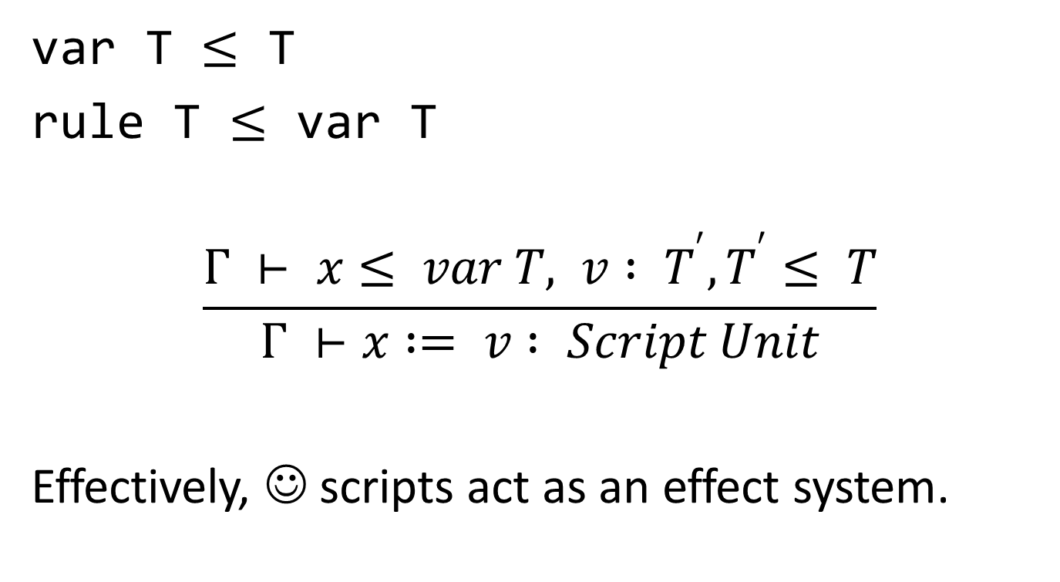
Typing Assignment
var T $≤$ T
rule T $≤$ var T
$$\frac{Γ ⊢ x≤ var T, v : T^{′}, T^{′}≤ T}{Γ ⊢x := v : Script Unit}$$
Effectively, ☺ scripts act as an effect system.

Slide 13
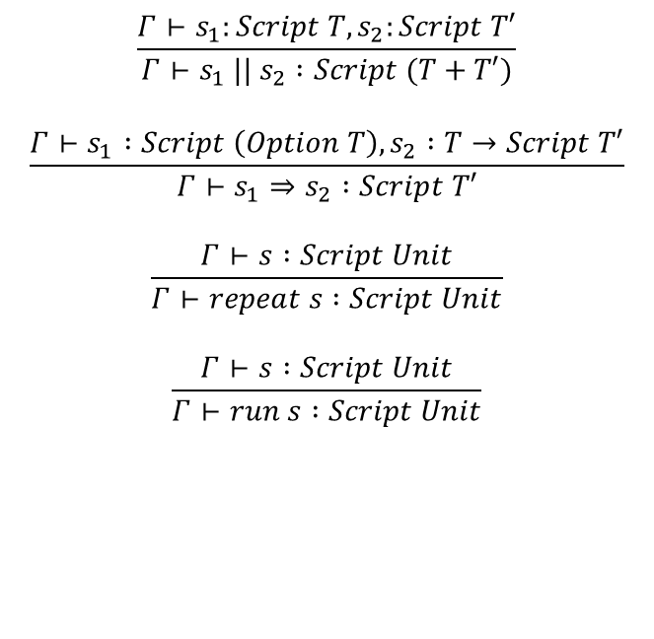
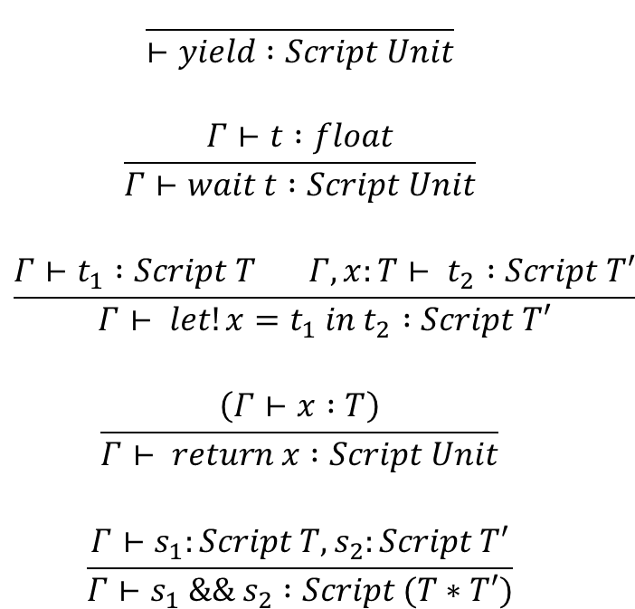
Typing script combinators
$$\frac{ }{⊢yield :Script Unit}$$
$$\frac{Γ⊢t :float}{Γ⊢wait t :Script Unit}$$
$$\frac{Γ⊢t_{1} :Script T Γ,x:T⊢ t_{2} :Script T′}{Γ⊢ let!x=t_{1} in t_{2} :Script T′}$$
$$\frac{\left(Γ⊢x :T\right)}{Γ⊢ return x :Script Unit}$$
$$\frac{Γ⊢s_{1}:Script T, s_{2}:Script T′}{Γ⊢s_{1} \&\& s_{2} :Script (T∗T′)}$$
$$\frac{Γ⊢s_{1}:Script T, s_{2}:Script T′}{Γ⊢s_{1} || s_{2} :Script (T+T′)}$$
$$\frac{Γ⊢s_{1} :Script \left(Option T\right), s_{2} :T→Script T′}{Γ⊢s_{1}⇒s_{2} :Script T′}$$
$$\frac{Γ⊢s :Script Unit}{Γ⊢repeat s :Script Unit}$$
$$\frac{Γ⊢s :Script Unit}{Γ⊢run s :Script Unit}$$

Slide 14

Typing main and input scripts
$$state :GameState⊢main :Script Unit$$
$$\frac{\begin{aligned}state :GameState⊢event_{i} :Script\left(Option α\right) \\ state :GameState⊢response_{i} :α→Script Unit\end{aligned}}{⊢event_{i}⇒response_{i} :Script Unit}$$

Slide 15
Types Translation
We turn Casanova types into F# types
Rule terms are ignored (for the moment)
Rule fields assume the type
type Rule<'a> = { mutable Current : 'a; mutable Next : 'a }
Plus smart properties

Slide 16
Example rule translation
Casanova:
type Ship = { Position : rule Vector2 = ... }
F#
type Ship = { _Position : Rule<Vector2> = ... }
member this.Position
with get() = this._Position.Current
and set p' = this._Position.Next <- p'

Slide 17
Update Semantics
We “compute” the Update function from the state and its rules
Traverse the state and its entities
Apply the rules (with effects), to the appropriate fields
Swap the Current and Next fields of each rule

Slide 18

Query Optimizations
Indexed quadratic queries
$O\left(n^{2}\right)→O\left(n\log{n}\right)$

Slide 19
Rule Swapping
type Rule<'a> = { Values : 'a[]; Index : int ref }
member this.Current with get() = Values.[!Index % 2]
member this.Next with set v' = Values.[(!Index+1)%2] <- v'

Slide 20
Rules of lists
Instead of reallocating lists, we recycle:
Xs : rule list int =
(fun state,self,dt) -> [x + 1 | x <- self.Xs]
self._Xs.Next.Clear()
for x in self._Xs.Current do
do self._Xs.Next.Add (x+1)

Slide 21
Async Evaluation of Rules
Rules may be evaluated in parallel
no conflicts: each rule reads Current but writes Next

Slide 22
Rendering
Declarative rendering
Render operation = drawable data structure inside the game state

Slide 23
2D rendering
type Picture = { mutable Path : string;
mutable Position : Vector3
mutable Size : Vector2
mutable Tint : Vector4 }

Slide 24
3D rendering
type Model = { mutable Path : string;
mutable World : Transform
mutable Camera : Camera }

Slide 25
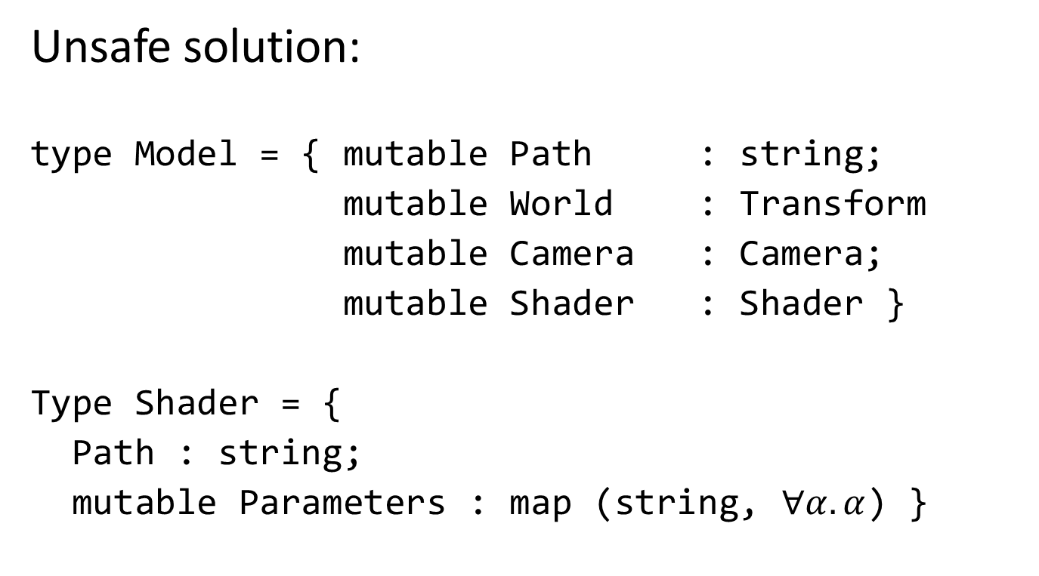
Rendering Custom Effects
Unsafe solution:
type Model = { mutable Path : string;
mutable World : Transform
mutable Camera : Camera;
mutable Shader : Shader }
Type Shader = {
Path : string;
mutable Parameters : map (string, $∀α. α$) }

Slide 26
Representing Shaders
Inline code in the Casanova source, which instances the following type:
type Shader 'p = { Code : ShaderCode 'p; Parameters : 'p }
'p is a record (generated by the compiler) with a field for each parameter of the shader

Slide 27
Networking
Naïve solution:
Send all the state from host to clients
Send input events from clients to host
Client does not perform any write operation

Slide 28
Shortcomings
Extreme lag on the clients
Excessive bandwidth usage

Slide 29
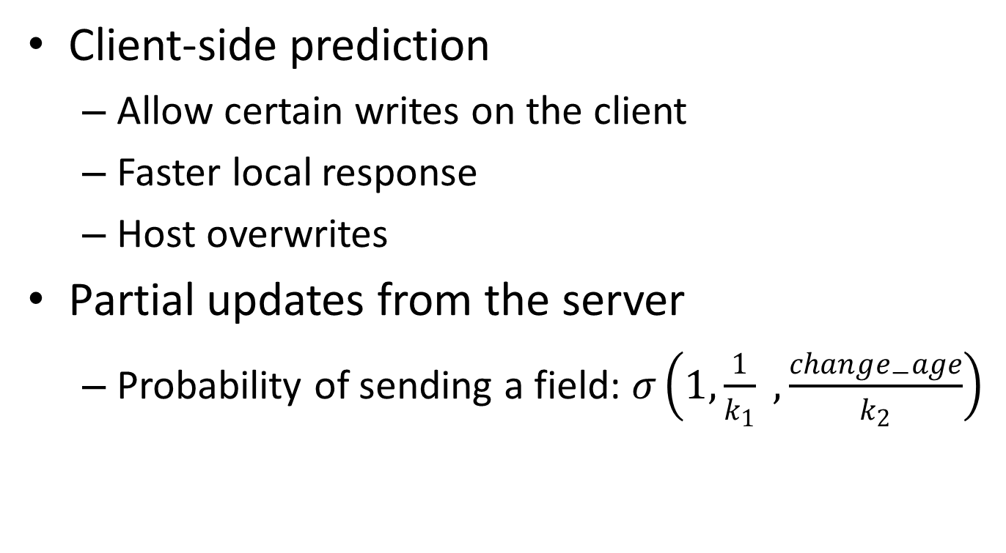
Solutions
Client-side prediction
Allow certain writes on the client
Faster local response
Host overwrites
Partial updates from the server
Probability of sending a field: $σ\left(1,\frac{1}{k_{1}} , \frac{change_{−}age}{k_{2}}\right)$

Slide 30
Sample Entity
type Ship =
{ synchronize(period = 20, time = inf, predict = true)
Position : var Vector2
synchronize(period = 20, time = 0.5, predict = false)
Strength : var int
Source : Planet
Target : Planet
Owner : Player }
Unspecified fields use default sync annotation (60, 2, false).

Slide 31
Missing Stuff
Twitch games (e.g. shooters) multiplayer:
Dead reckoning
Local approximation used for targeting; hits sent to the server from the client

Slide 32
Conclusions
A comprehensive, clean model for making games
Language
Design pattern
Crucial areas of game dev. Are covered
Logic
Input
Rendering
Networking
Something still missing
Audio
Menu

Slide 33
Thank you ☺

